Slide 1
Lecture 11
Nick Rugai PhD

Slide 2
Dictionaries
A dictionary is a mapping similar to a list.
The index of a list is an integer.
The index of a dictionary can be of any type.

Slide 3
Dictionaries
Let’s create a dictionary:
e2s=dict() #creates and empty list
e2s
{}
e2s[‘one’]=’uno’
e2s
e2s = {‘one’: 'uno', 'two': 'dos', 'three': 'tres'}
Let’s try e2s[‘four’]

Slide 4
Dictionaries
‘one’ in e2s #’one’ is a key
‘uno’ in e2s #’uno’ is a value
v = e2s.values()
‘uno’ in v

Slide 5
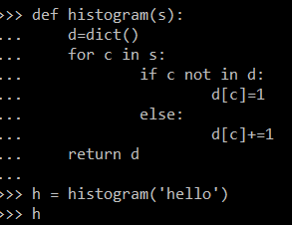
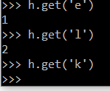
Dictionaries
Let’s create a histogram using a dictionary:

Slide 6
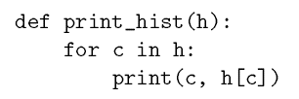

Dictionaries
Traversing:

Slide 7
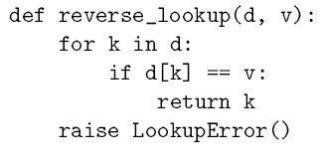
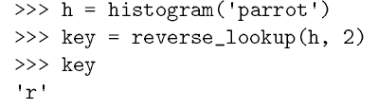
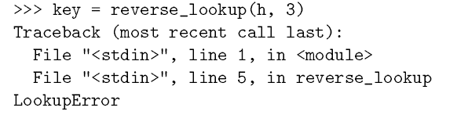
Dictionaries
Reverse Lookup:

Slide 8
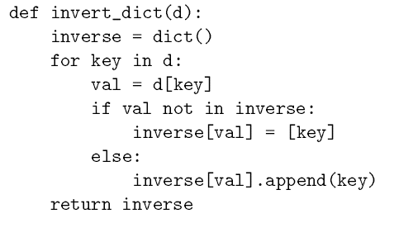
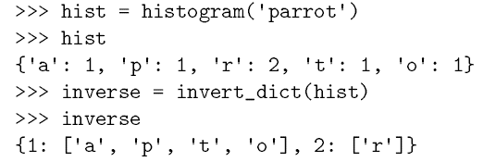
Dictionaries
Inverting a dictionary:

Slide 9
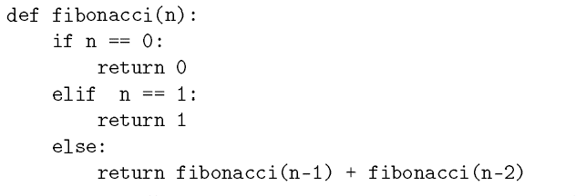
Dictionaries
Let’s rewrite the Fibonacci function:
Try to run 38 as argument

Slide 10
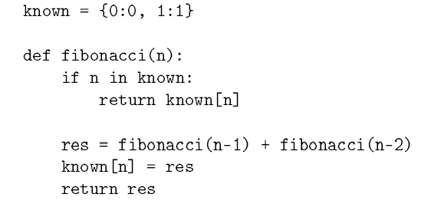
Dictionaries
Let’s rewrite the Fibonacci using dictionaries:
Try to run 38 as argument twice

Slide 11
Variables
known in the previous example is a global variable.
While res is a local variable.
Using ‘global’ makes a global variable available anywhere.

Slide 12
Variables
k = 0
def temp():
k=100
k
def temp():
global k
k=100
k

Slide 13
Quiz 3 and Program 3

